Slide 1
Multiple Translations of the Bible on Christian Unity
Melody Sarno

Slide 2
"I pray not only for them, but also for those who will believe in me through their word, so that they may all be one, as you, Father, are in me and I in you, that they also may be in us, that the world may believe that you sent me. And I have given them the glory you gave me, so that they may be one, as we are one, I in them and you in me, that they may be brought to perfection as one, that the world may know that you sent me, and that you loved them even as you loved me.” (John 17:20-23)

Slide 3
“Division openly contradicts the will of Christ, provides a stumbling block to the world, and inflicts damage on the most holy cause of proclaiming the Good News to every creature.”
Pope John Paul II’s encyclical letter Ut Unum Sint ("That They Be One")

Slide 4
The Original Texts
Languages of the Bible: Greek, Latin, Aramaic
Who spoke what
Why those languages were chosen

Slide 5
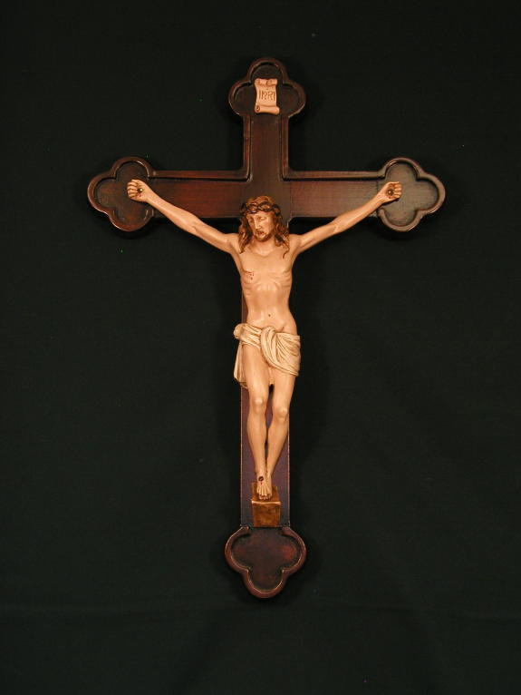
Translating
Failure to elaborate
Punctuation fixes
Alternate Interpretations

Slide 6
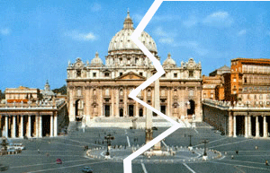
Separation
Great Schism
Reformation
Negative effects

Slide 7
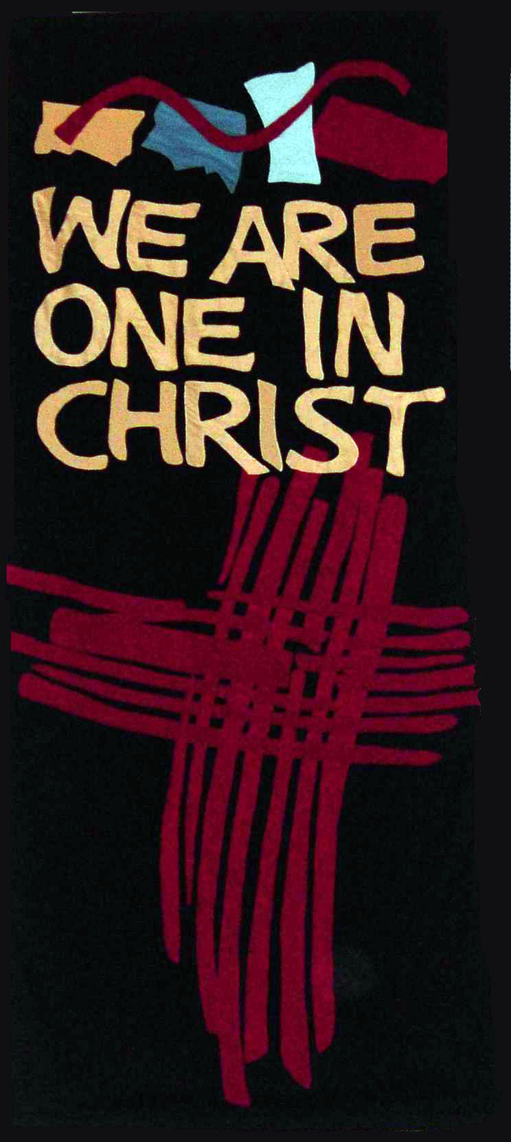
Importance
Understanding languages
Hope for unity

Slide 8
Limites
Not knowing these languages myself

Slide 9
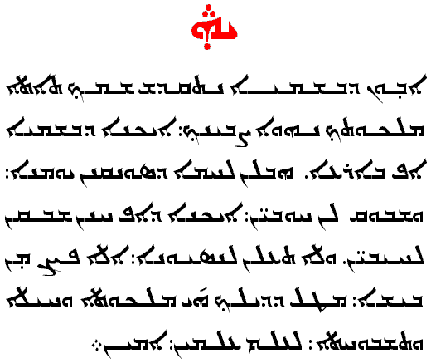
Action
A form of UN for religion
Theologians and biblical scholars
Learn a few words from Greek, Latin, and Aramaic

Slide 10
Potential Committee Members
Mr. C
Ms. Melton

