Slide 1
Should everyone follow the morals of the ten commandments?
Georgette Sarno

Slide 2
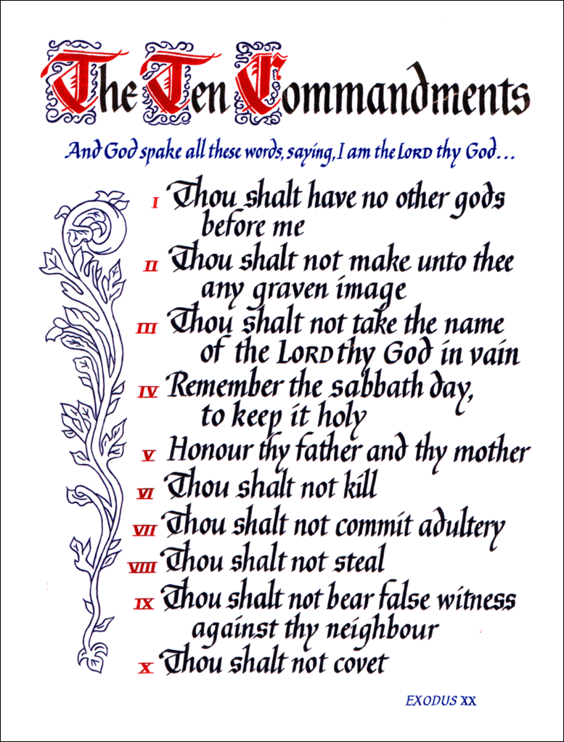
How I got the question
Internet search
Thought it to be deep and exciting

Slide 3
Sections of the paper
Explanation of what the Ten Commandments are
Different religions and their beliefs
The brain’s involvement
Experiments
Metaphors
Final Analysis
Answer

Slide 4
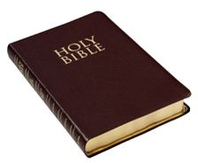
The Ten Commandments
Where they are found
Who believes in them

Slide 5
Literal purpose of the Ten Commandments
Purpose
Comparison of them to the universal code

Slide 6
Religions
Buddhism
Hinduism
Christianity

Slide 7
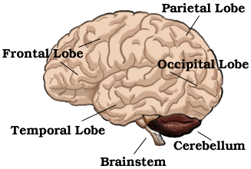
The Brain
Experiemnts
Outcomes

Slide 8
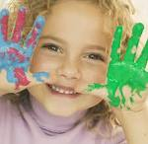
Children
Experiments
Outcomes

Slide 9
Metaphors
Art
Food
SAT/ACT Scores
China’s economy
Papa New Guinea

Slide 10
Closing
Repetition of what was found
Analysis
Factors
Final Definition

Slide 11
Action
Mission trip

Slide 12
Citations
http://www.handofgod.com.au/page300.php
http://www.waiting.com/brainanatomy.html
http;//www.babyandkidallergies.com
http://www.fumcrockwall.com/520855.ihtml

