Slide 1
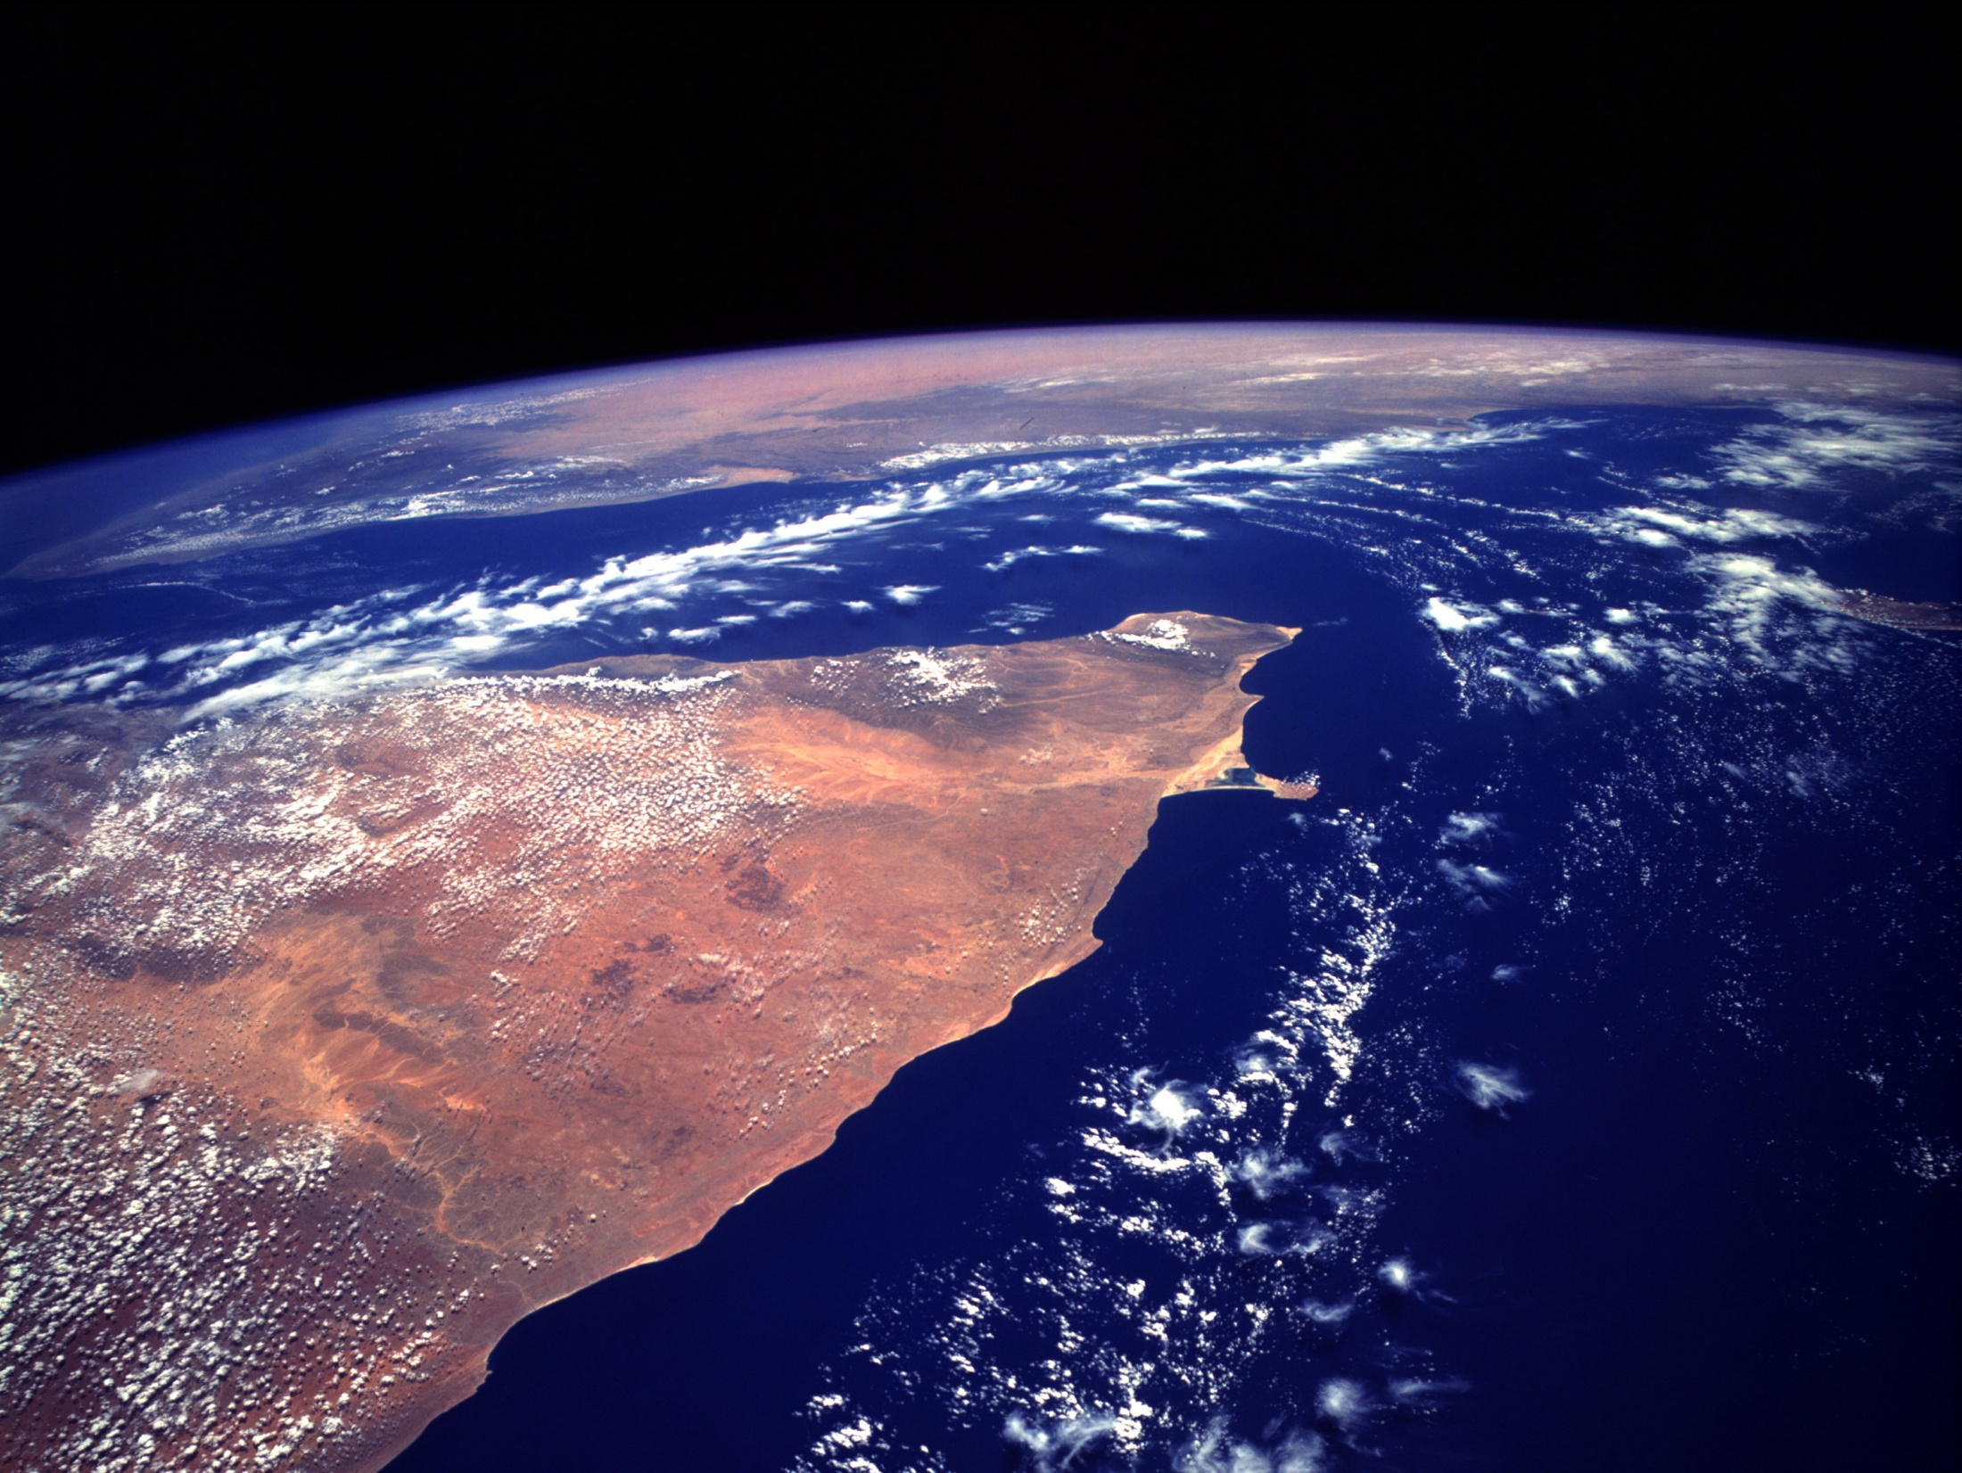
The Horn of Africa
Paul Friesz
Emily Saunders
Melody Sarno

Slide 2
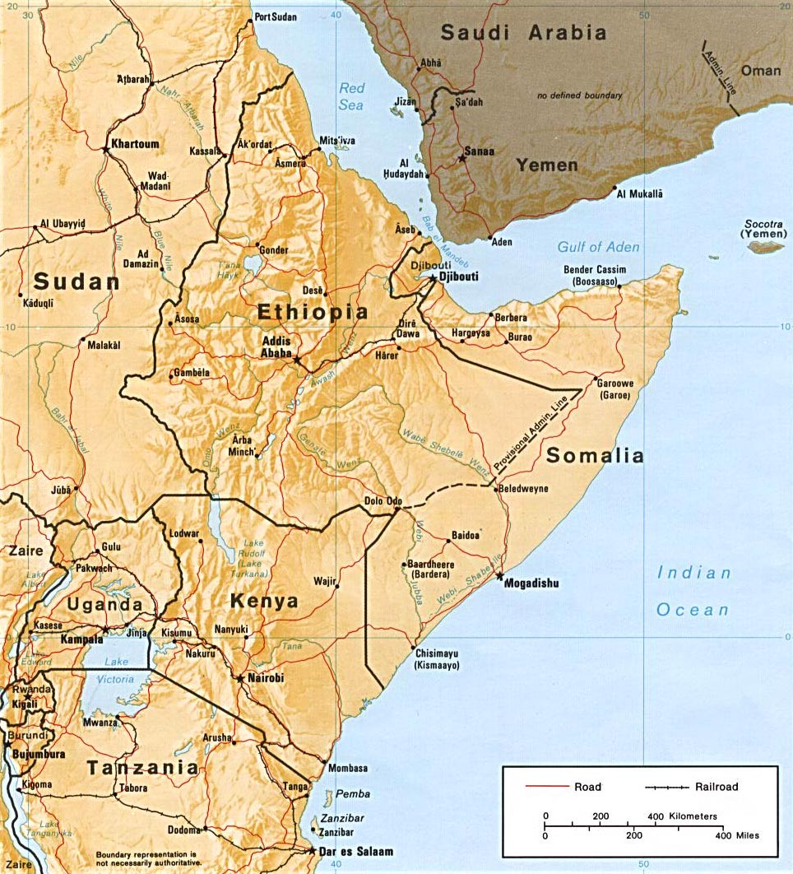
Horn of Africa
Djibouti
Eritrea
Ethiopia
Somalia
Sudan

Slide 3
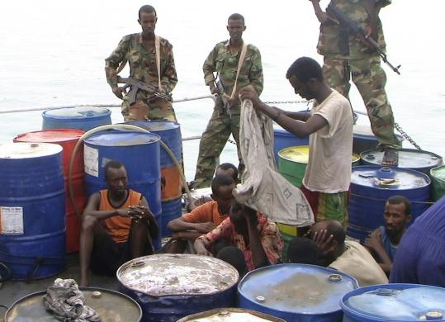
Why does the International community care?
Political Upheaval = Domino effect
Civil war in Darfur, Sudan
Natural Resources
Somali Pirates
Terrorism
Oil

Slide 4
Lessons from the Horn of Africa
History can repeat itself
Government is always susceptible to failure
Proceed with caution when dealing with foreign aid

Slide 5
UN Missions
Due to not being able to fight back, many soldiers were wounded or even killed
The missions all failed, due to casualties & missions being cut short

Slide 6
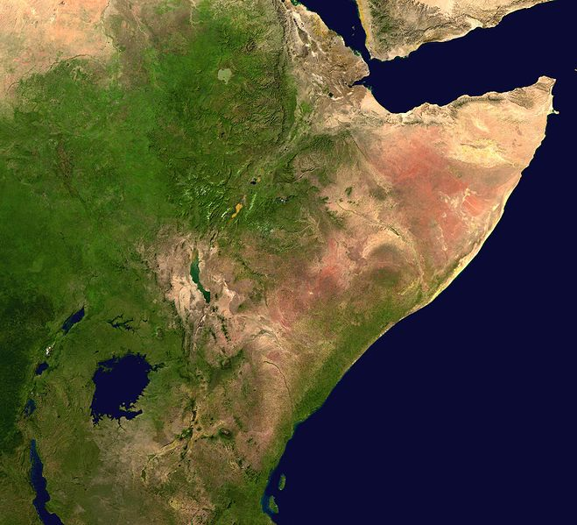
Should we walk away?
The Horn still has things to offer
Breeding ground for terrorism groups
People are in turmoil
What would you do if it were your family?

Slide 7
Should we fight the Somali pirates onshore?
We have to weigh the pros and cons
Examine every angle
“The root causes of piracy are poverty and lawlessness, and these root causes need to be addressed, rather than causing more devastation to Somalia. First and foremost, economic aid is necessary. Only after that, would the international community’s presence eventually be able to work.”

Slide 8
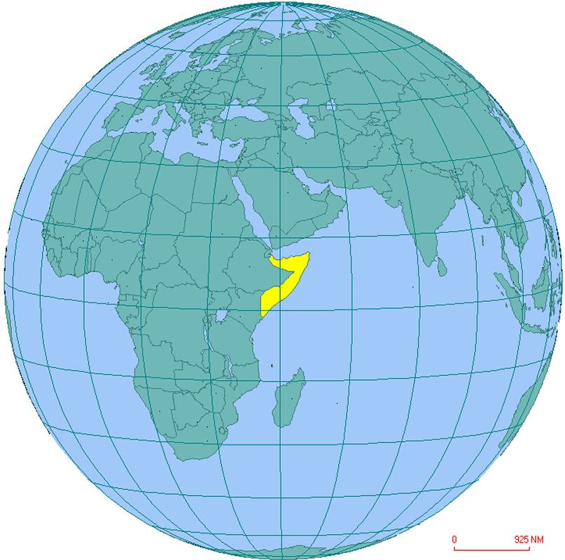
Why do we support Ethiopia?
Wanted to get rid of the United Islamic Courts (UIC)
Rid the world of its’ leader Sheikh Hassan Dahir
Establish legitimacy of Somalia's Transitional Federal Government

Slide 9
Should Obama be involved with Sudan?
A long term commitment
In the past, it led to further atrocities

Slide 10
Sudan & Ethiopia: Good investment or waste of money
Their economies are suffering; however,
they have abundant natural resources
Aid should be spread evenly

Slide 11
Should the US become involved in the Eritrea-Ethiopia border dispute?
Focus on one thing at a time
Disadvantages
US may gain enemies
Large investment

